Slide 1

University of Bisha
College of Computing and Information Technology
GRADUATION PROJECT
Malicious URL Detection with DistilBERT
Supervised by: Dr. Ali Almaliki
Prepared by
Hajar Hajd Alharthi 444802005
Najla Mohammed Gaashan 444806513
Asma Masoud Alshahrani 443801321
Rawan Mohammed Alharthi 443801335
Rawan Moshabab Alshahrani 444803633
Anfal Nasser Al Mashout 444804227
Shooq Mohammed 443801328
Jana Mohsen Alghamdi 443803423

Slide 2
ABSTRACT
Project Abstract
Malicious URLs are a primary vector for phishing, malware distribution, and website defacement, and traditional detectors that rely on handcrafted lexical rules or blacklists struggle to keep pace with rapidly evolving attacks. This project presents a transformer-based system that classifies URLs into four categories — benign, phishing, malware, and defacement — by fine-tuning DistilBERT directly on raw URL text, removing the need for manual feature engineering. A public Kaggle dataset of roughly 651,000 labeled URLs was split into stratified training, validation, and test sets. The model was fine-tuned end-to-end using the HuggingFace Trainer API and evaluated on a held-out test set of about 97,000 URLs, achieving 98.89% accuracy and a macro F1-score of 0.9835. The results show that a lightweight transformer can reliably detect malicious URLs from text alone, offering a practical alternative to rule-based detection pipelines.
02

Slide 3
INTRODUCTION
How the Project Was Built
Algorithm Workflow
Training ↔ Testing Relationship
1
Collect and clean the labeled URL dataset
Training set (70%)
2
Tokenize URLs with the WordPiece tokenizer
Used to update DistilBERT's weights via backpropagation.
Stratified train / validation / test split
Validation set (15%)
3
Used after every epoch to pick the best model — never used to update weights.
4
Fine-tune DistilBERT end-to-end
Test set (15%)
Held out completely until the very end, for one unbiased final measurement.
5
Validate each epoch, keep the best model
Same fixed random seed for every split — so the test score reflects real generalization, not a lucky split.
6
Evaluate once on the held-out test set
03

Slide 4
MOTIVATION
Malicious URLs Are a Growing Attack Surface
1
2
3
Phishing
Malware
Defacement
Fake login pages impersonate trusted brands to steal credentials.
Links trigger drive-by downloads of malicious payloads.
Compromised sites serve altered or hostile content.
The challenge: classic detectors rely on hand-crafted features (blacklists, WHOIS lookups, lexical rules) that are brittle and slow to update against fast-evolving attacks.
04

Slide 5
DATASET
Malicious URLs Dataset (Kaggle)
~651,000
Four Target Classes
labeled URLs across 4 classes, sourced from the public Kaggle
"Malicious URLs Dataset"
Benign
Source: Kaggle – Malicious URLs Dataset
Phishing
Stratified Split (fixed seed 42)
Malware
Train
70%
Defacement
Validation
15%
Tokenization: DistilBERT WordPiece tokenizer, max 64 tokens per URL — no manual feature extraction.
Test
15%
Class proportions preserved in every split
05

Slide 6
METHODOLOGY
End-to-End Classification Pipeline
Raw URL
WordPiece
Tokenizer
DistilBERT
Encoder
Classification
Head
Verdict +
Confidence
http://secure-login...
paypa1-account.example
▶
Max 64 tokens
no manual features
▶
distilbert-base-uncased
~40% fewer params than BERT
▶
4-way softmax over
URL categories
▶
Below 0.60 →
flagged “uncertain”
The same pipeline runs at inference — the CLI, evaluation script, and web demo all call one shared prediction module.
06

Slide 7
ARCHITECTURE
Model Architecture
1
URL Input
Layer-by-Layer Specs
↓
URL Input
2
Tokenizer
Raw string passed in as-is — e.g. http://secure-login.paypa1-account.example/verify
↓
Tokenizer
DistilBERT Encoder
DistilBERT WordPiece tokenizer, max 64 tokens, no manual feature extraction
3
DistilBERT Encoder
↓
6 transformer layers, ~66M parameters — about 40% smaller than BERT-base
4
Dense Layer
Dense Layer
Linear projection from the encoder's hidden size down to 4 output classes
↓
Softmax
5
Softmax
Converts the raw logits into a 4-way probability distribution
↓
Class Prediction
Class Prediction
Argmax + confidence score; below 0.60 the URL is flagged “uncertain”
6
07

Slide 8
MODEL CHOICE
Why DistilBERT Over Full BERT?
URLs are short sequences — a lighter encoder trades a small amount of capacity for large gains in speed, without giving up accuracy.
 | BERT-base | DistilBERT
Parameters | ~110M | ~66M (↓ 40%)
Transformer layers | 12 | 6
Suited to short text (URLs) | Adequate | Strong
Inference latency | Higher | Lower
Achieved test accuracy | — | 98.89%
08

Slide 9
TRAINING
Fine-Tuning Configuration
Epochs
Optimizer
3
AdamW
Learning rate
Batch size
2e-5
16
Weight decay
Framework
0.01
HuggingFace Trainer API
Recommended: a CUDA-capable GPU for training (~450K training URLs × 3 epochs) — Google Colab's free T4 works well. Inference runs comfortably on CPU.
09

Slide 10
RESULTS
Test-Set Performance
98.89%
overall accuracy across ~97,000 held-out URLs
98.61%
98.09%
Macro Precision
Macro Recall
98.35%
Macro F1-Score
10

Slide 11
RESULTS
Per-Class Metrics
Class | Precision | Recall | F1-Score
Benign | 0.9922 | 0.9944 | 0.9933
Phishing | 0.9641 | 0.9596 | 0.9619
Malware | 0.9908 | 0.9705 | 0.9805
Defacement | 0.9974 | 0.9991 | 0.9982
Macro Avg | 0.9861 | 0.9809 | 0.9835
Phishing is the hardest class (borderline URLs resemble benign login pages) — still 96%+ F1. Defacement is near-perfect due to distinctive lexical patterns.
11

Slide 12
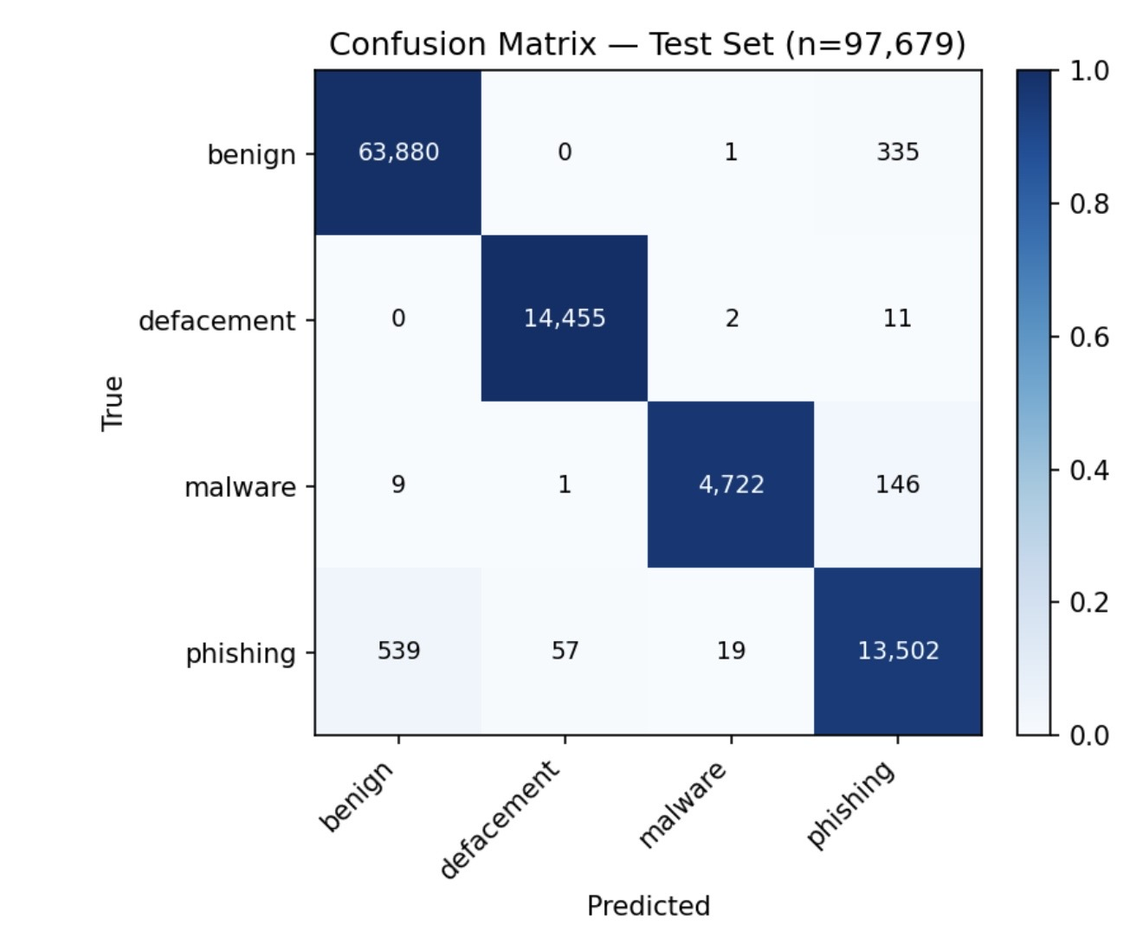
RESULTS
Confusion Matrix
Most predictions lie on the main diagonal, indicating excellent classification performance.

Slide 13
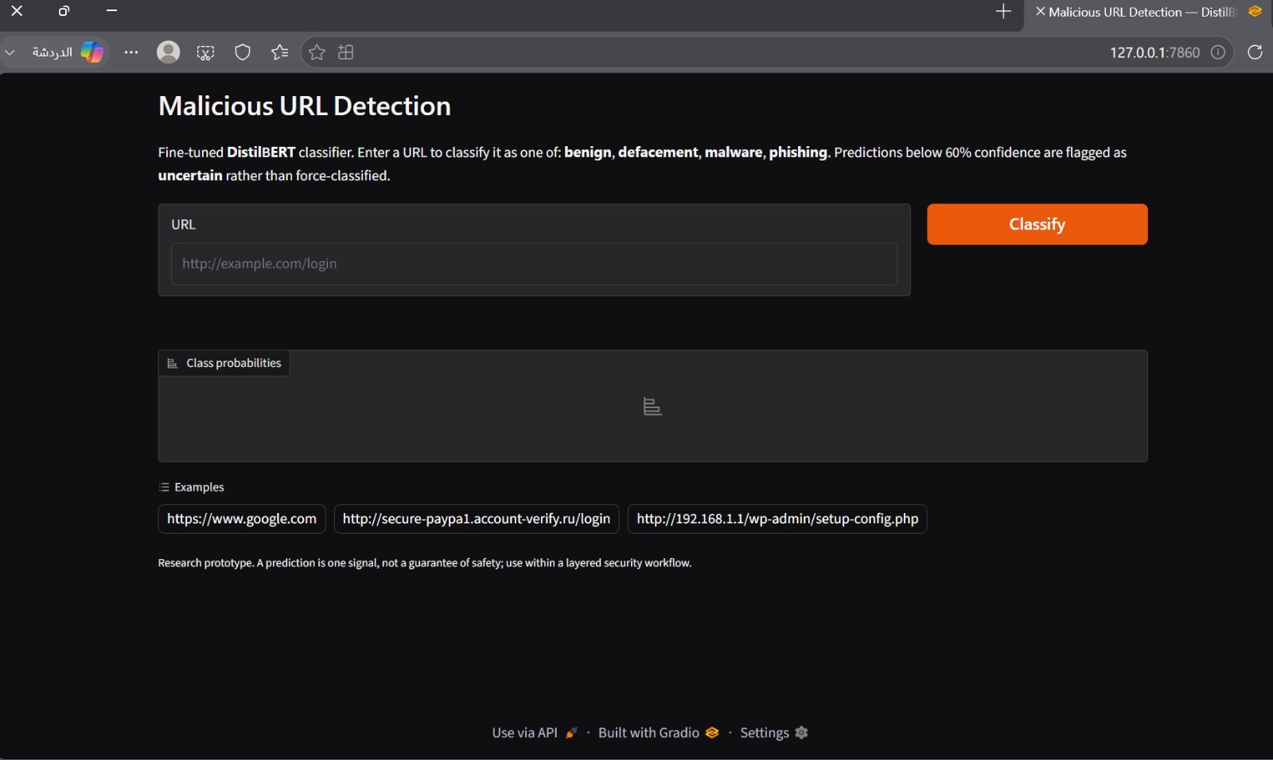
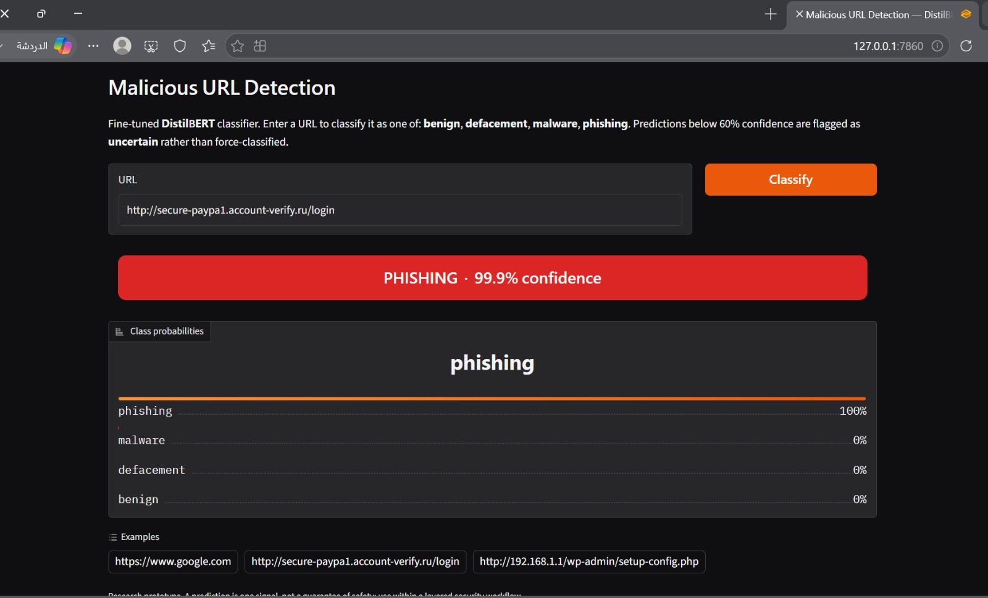
PRACTICAL PART
Working Demo — Live Classification
Real-Time URL Classification
Live Demo — Actual Screenshots
Enter any URL and get a real-time prediction
Confidence score with full class-probability bars
Predictions below the 0.60 threshold flagged as “uncertain” rather than force-classified
Enter a URL to classify
Phishing detected — 99.9% confidence
Captured directly from the deployed Gradio web app — not a mockup
Runs the exact same trained model used for the reported test results
12

Slide 14
CONCLUSION
Key Takeaways
98.89% accuracy
DistilBERT is enough
Classifying URLs into 4 categories using raw text alone, with zero handcrafted features.
A lighter, faster transformer matches the job — URLs are short sequences that don't need full BERT.
Reliable by design
Working end-to-end system
Stratified splits and a held-out test set mean the reported score reflects true generalization.
A trained model, an evaluation pipeline, and a live web demo — not just a notebook.
Ready to classify unseen URLs in real time.
13

Slide 15
FUTURE WORK
Where This Project Can Go Next
Deploy as a browser extension
1
Bring real-time URL checks directly into the user's browsing experience.
Train on continuously updated URL datasets
2
Keep the model current against newly emerging phishing and malware patterns.
Compare with larger transformer models
3
Benchmark against BERT-large or RoBERTa to measure the accuracy/speed trade-off.
14

Slide 16
Thank You
Questions & Discussion
Hajar Hajd Alharthi · Najla Mohammed Gaashan · Asma Masoud Alshahrani · Rawan Mohammed Alharthi
Rawan Moshabab Alshahrani · Anfal Nasser Al Mashout · Shooq Mohammed · Jana Mohsen Alghamdi
Supervised by Dr. Ali Almaliki

